Slide 1

Data Visualization with R
JASLEEN SONDHI
Azure Developer Community

Slide 2
Hi, I am Jasleen!
Aspiring Data Scientist and Gold Microsoft Learn Student Ambassador.
Currently in the final year of MSc. Data Science
Been published twice in the domain of R Programming and Big Data
#IamRemarkable Facilitator and Google Developers Group Lead @Google
Kolkata Chapter Lead @ Codecademy
Freelanced with brands like Scaler Academy and Unacademy

Slide 3
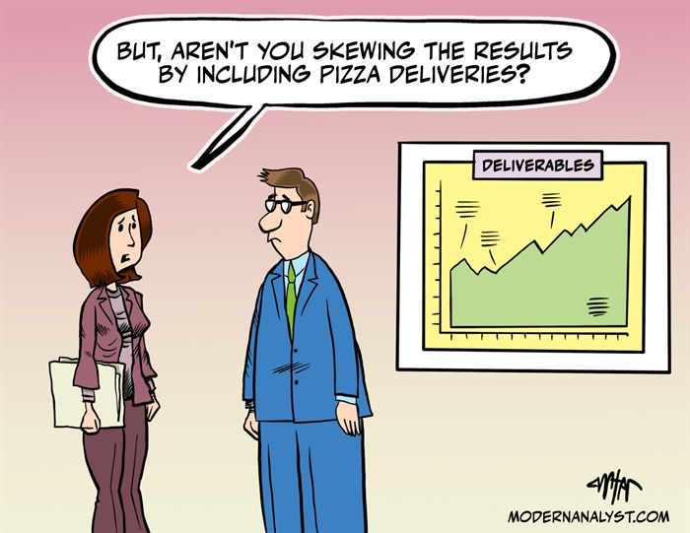
Agenda
Visualizing Proportions
Visualizing Relationships
Meaningful Visualizations

Slide 4
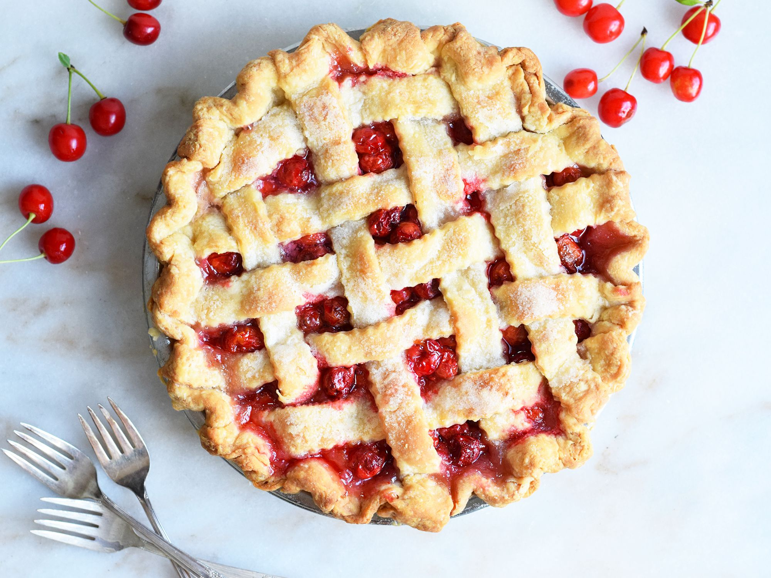
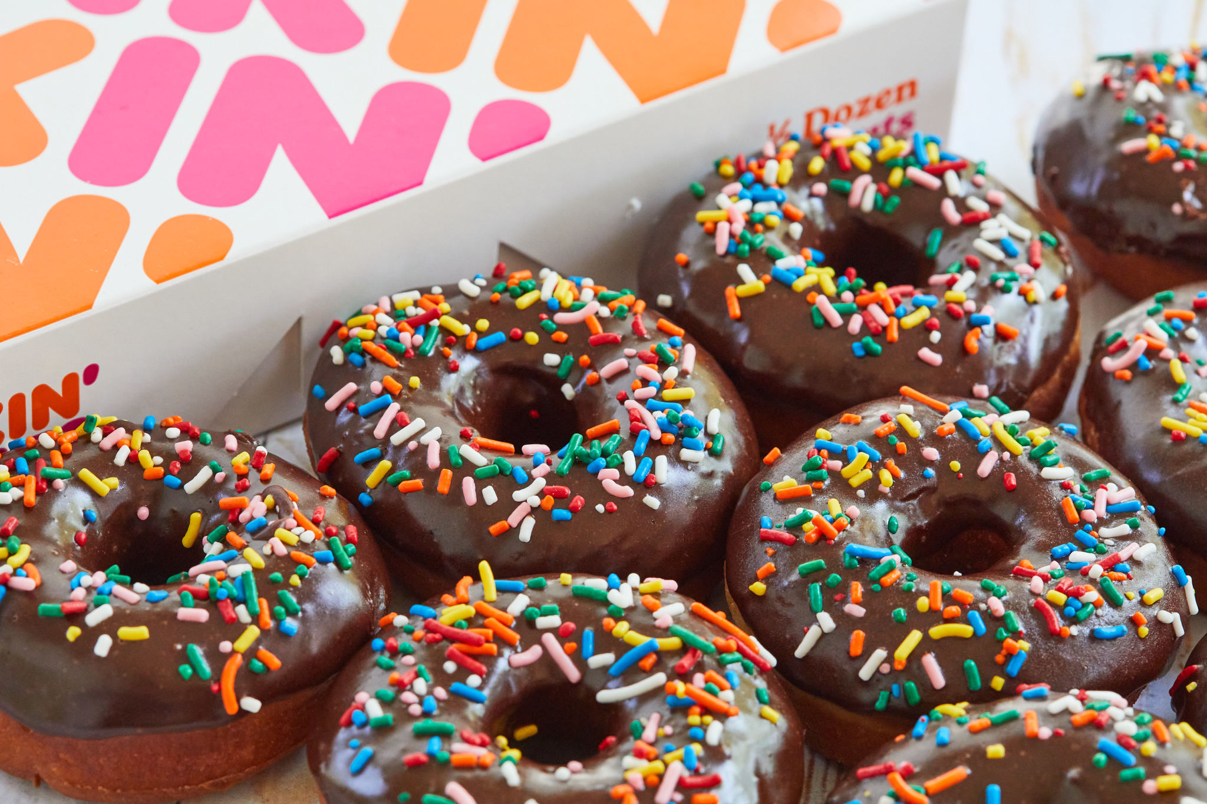
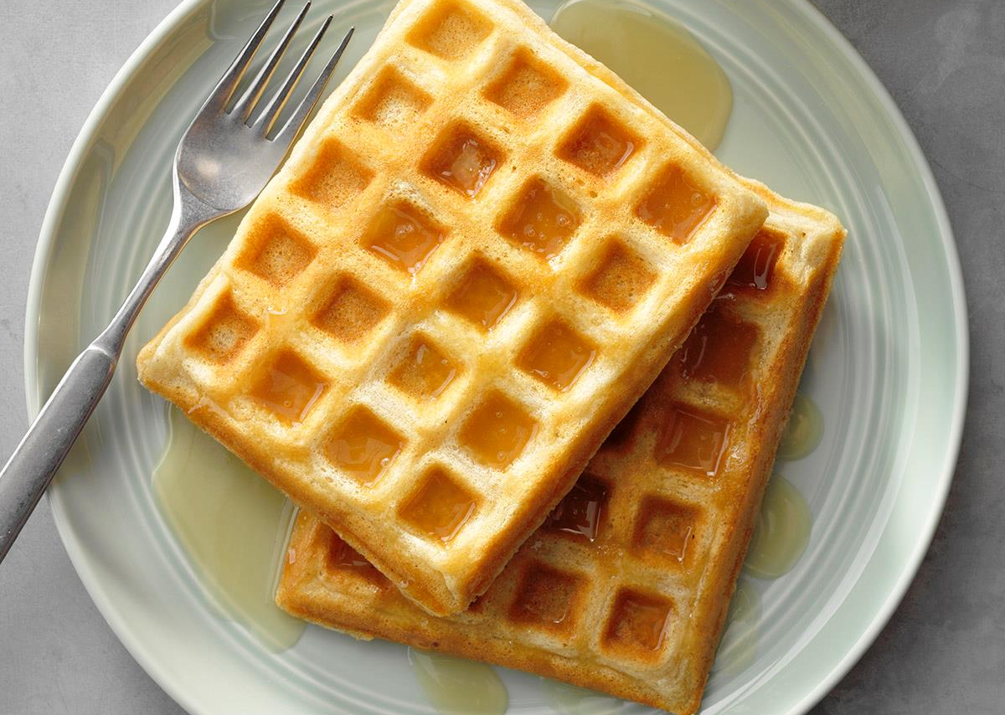
Visualizing Proportions
Pie charts 🥧
Donut charts 🍩
Waffle charts 🧇
Why use Pie charts?
Pie charts show the parts-to-whole relationship.
Why use Donut charts?
Donut charts are used to show the proportions of categorical data, with the size of each piece representing the proportion of each category.
Why use Waffle charts?
Waffle Charts are a great way of visualizing data in relation to a whole, to highlight progress against a given threshold.

Slide 5
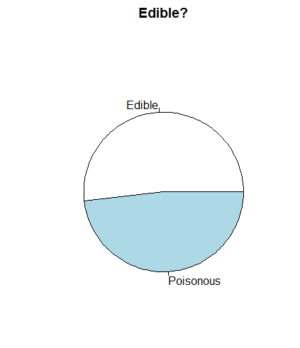
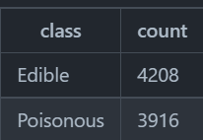
Let’s look at some code!
library(dplyr)
grouped=mushrooms %>%
group_by(class) %>%
summarise(count=n())
View(grouped)
pie(grouped$count,grouped$class, main="Edible?")

Slide 6
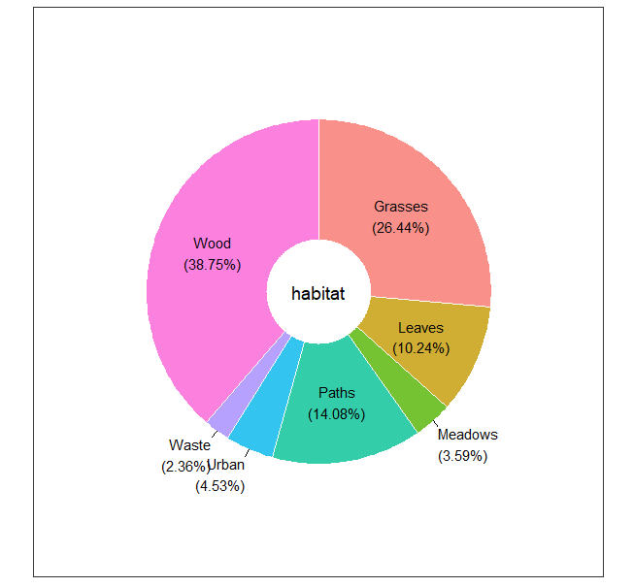
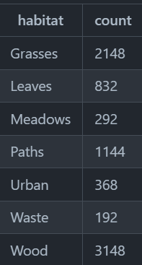
Let’s look at some code!
library(dplyr)
habitat=mushrooms %>%
group_by(habitat) %>%
summarise(count=n())
View(habitat)
library(ggplot2)
library(webr)
PieDonut(habitat, aes(habitat, count=count))

Slide 7
Let’s look at some code!
install.packages("waffle", repos = "https://cinc.rud.is")
library(dplyr)
cap_color=mushrooms %>%
group_by(cap.color) %>%
summarise(count=n())
library(waffle)
names(cap_color$count) = paste0(cap_color$cap.color)
waffle((cap_color$count/10), rows = 7, title = "Waffle Chart")+scale_fill_manual(values=c("brown", "#F0DC82", "#D2691E", "green", "pink", "purple", "red", "grey","yellow","white"))

Slide 8
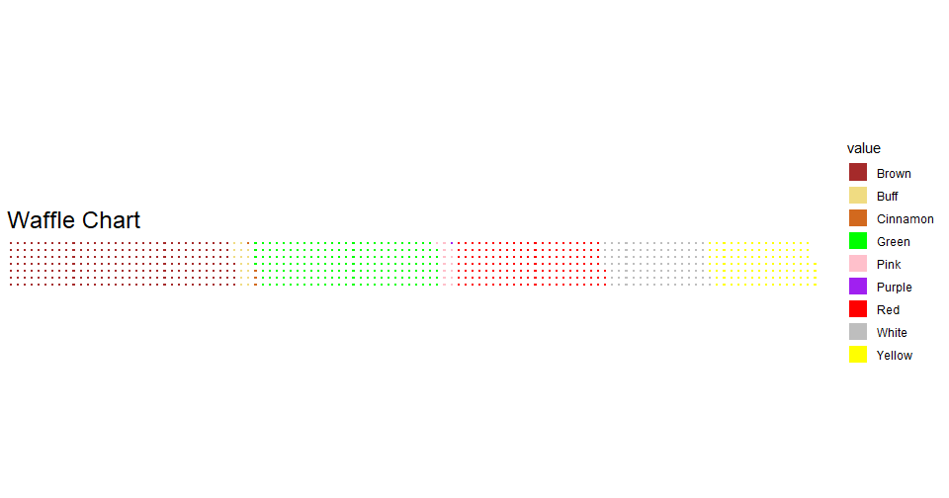
Let’s look at some code!

Slide 9
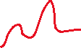







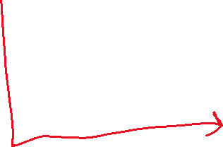

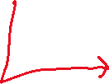
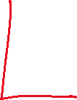






Visualizing Relationships
Scatterplots
Line Charts
Facet Grids
Dual Line Charts

Slide 10
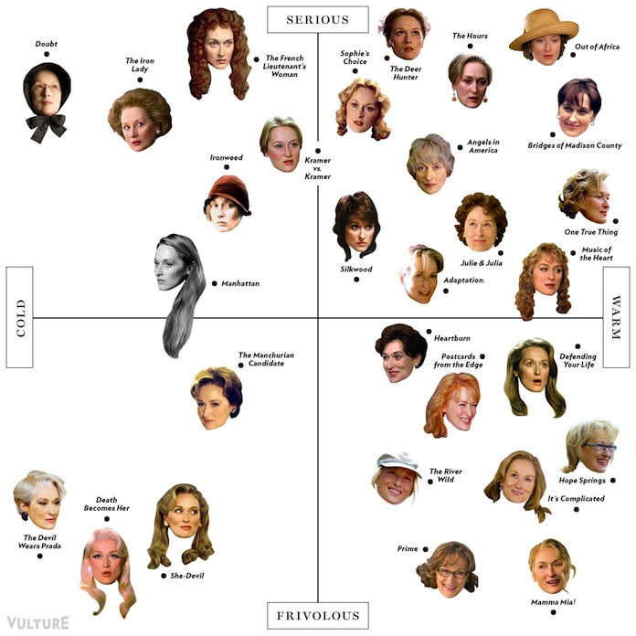
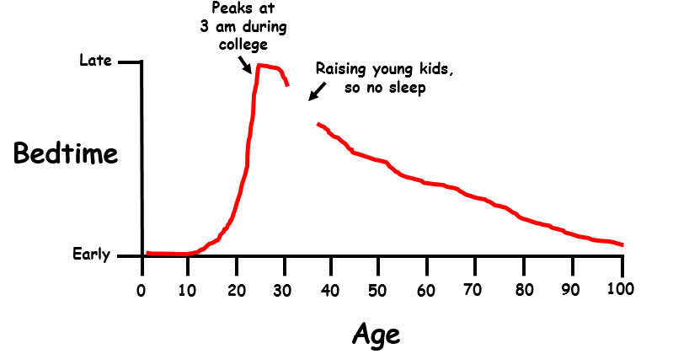
Visualizing Relationships

Slide 11
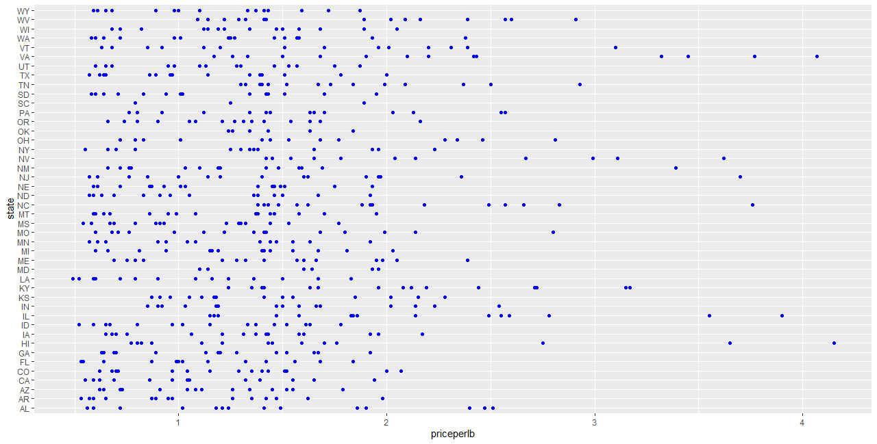
Let’s look at some code!
library(ggplot2)
ggplot(honey, aes(x = priceperlb, y = state)) + geom_point(colour = "blue")

Slide 12
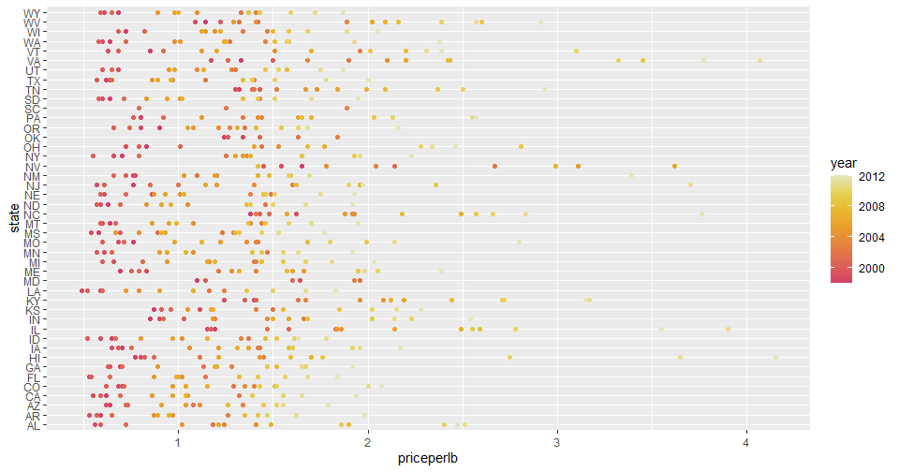
Let’s look at some code!
library(ggplot2)
ggplot(honey, aes(x = priceperlb, y = state, color=year)) + geom_point()+
scale_color_gradientn(colours = colorspace::heat_hcl(7))

Slide 13
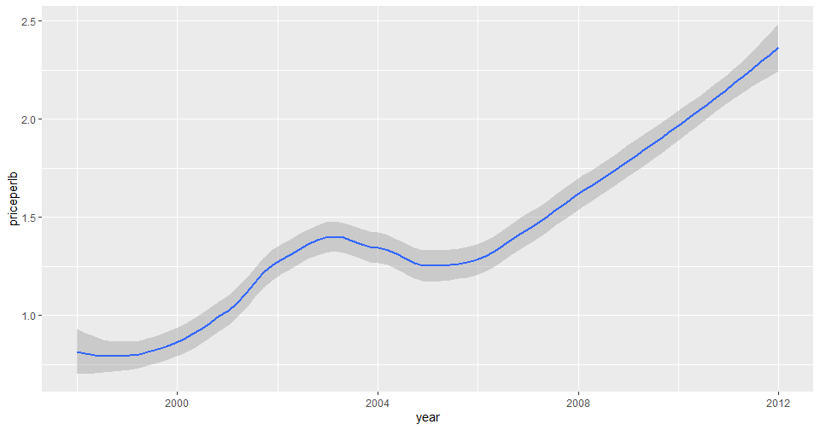
Let’s look at some code!
qplot(honey$year,honey$priceperlb, geom='smooth', span =0.5, xlab = "year",ylab = "priceperlb")

Slide 14
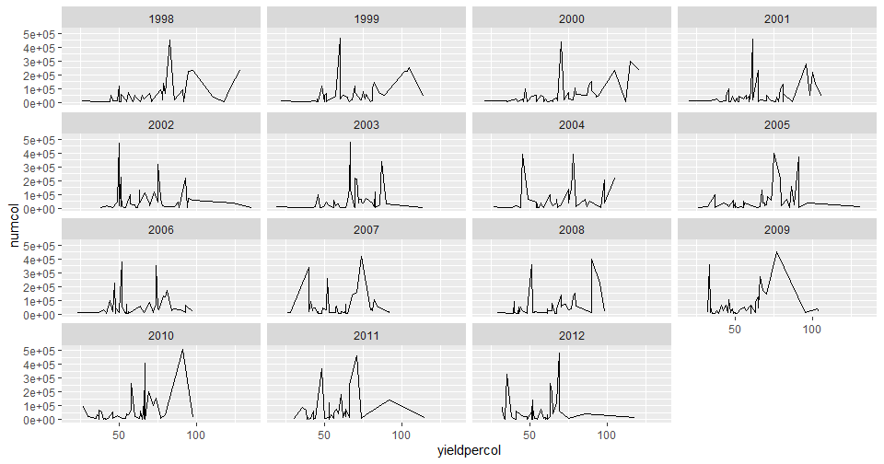
Let’s look at some code!
ggplot(honey, aes(x=yieldpercol, y = numcol,group = 1)) +
geom_line() + facet_wrap(vars(year))a

Slide 15
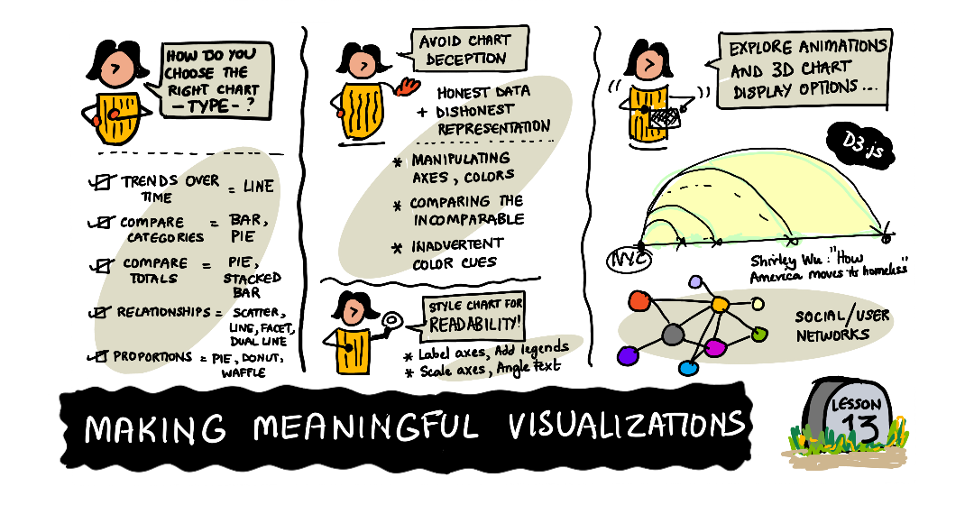
Making Meaningful Visualizations
One of the basic skills of a data scientist is the ability to create a meaningful data visualization that helps answer questions you might have.
Some important questions to ask yourself are-
What is the right chart type for me?
How can I avoid deceptive charting?
How to make color theory work in your favor?
How to build charts with high readability?
How to bring 3D charting solutions?
How to get creative with visualizations?

Slide 16
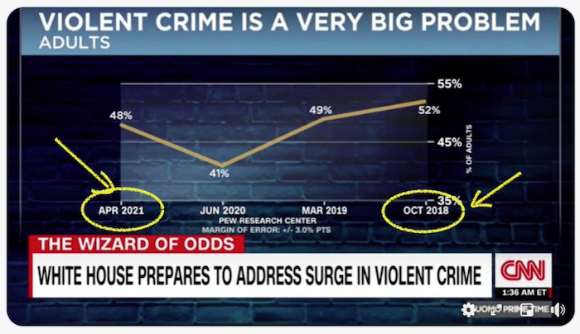
Making Meaningful Visualizations
Deceptive Charting

Slide 17
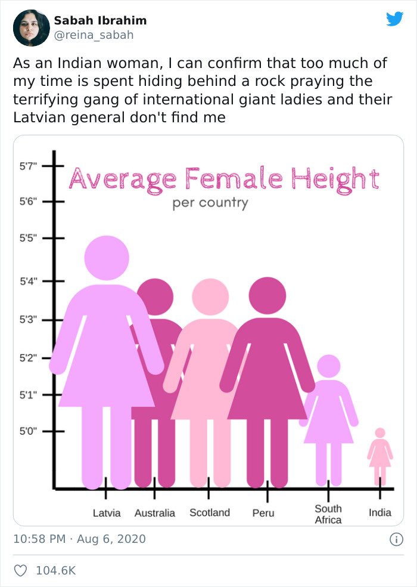
Making Meaningful Visualizations
Manipulated Proportions- To a hilarious effect!

Slide 18
Simple Guide for Visualizations
You need to: | You should use:
Show data trends over time | Line
Compare categories | Bar, Pie
Compare totals | Pie, Stacked Bar
Show relationships | Scatter, Line, Facet, Dual Line

Slide 19
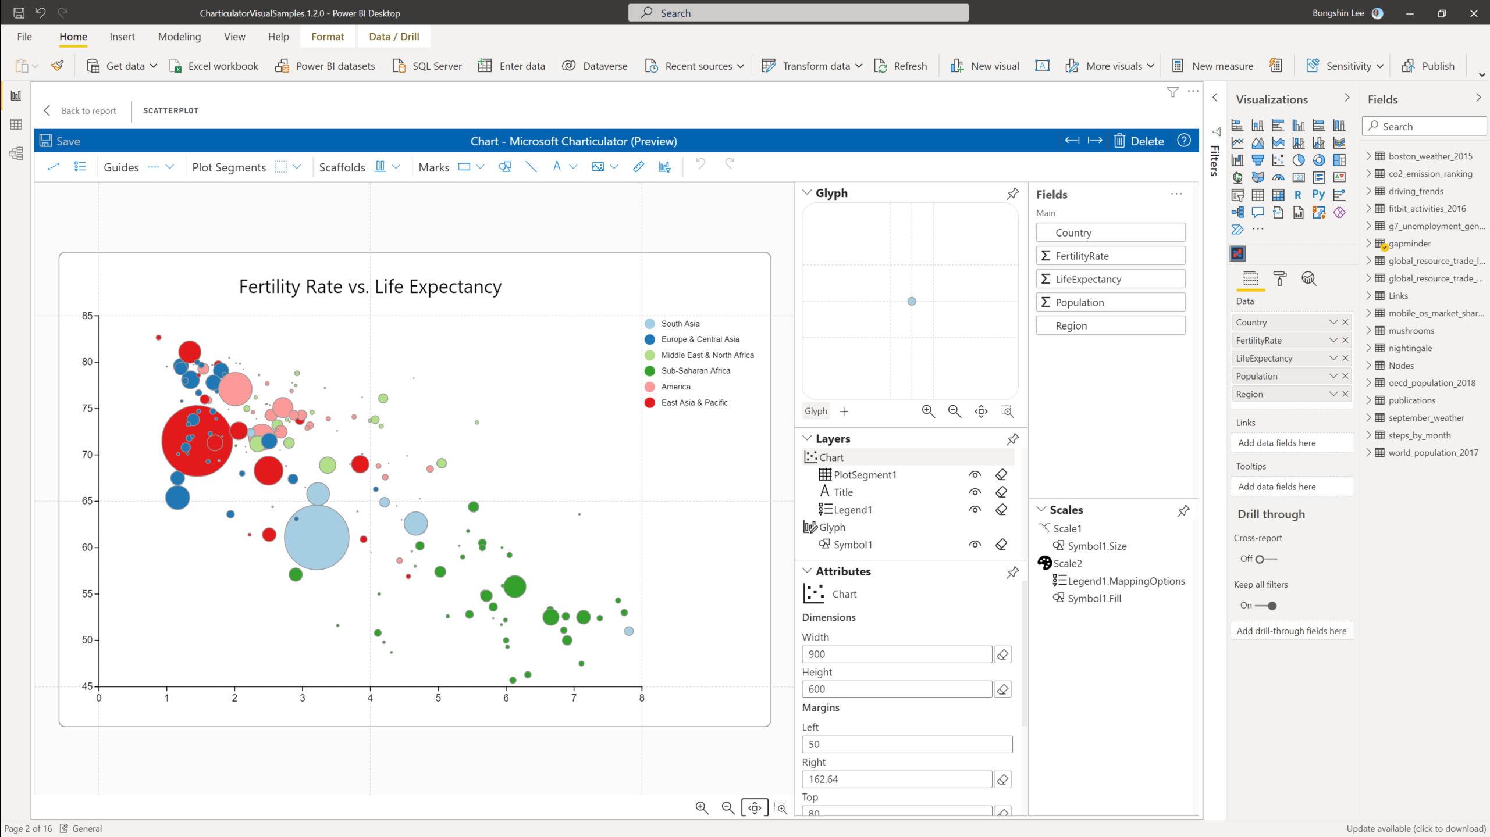
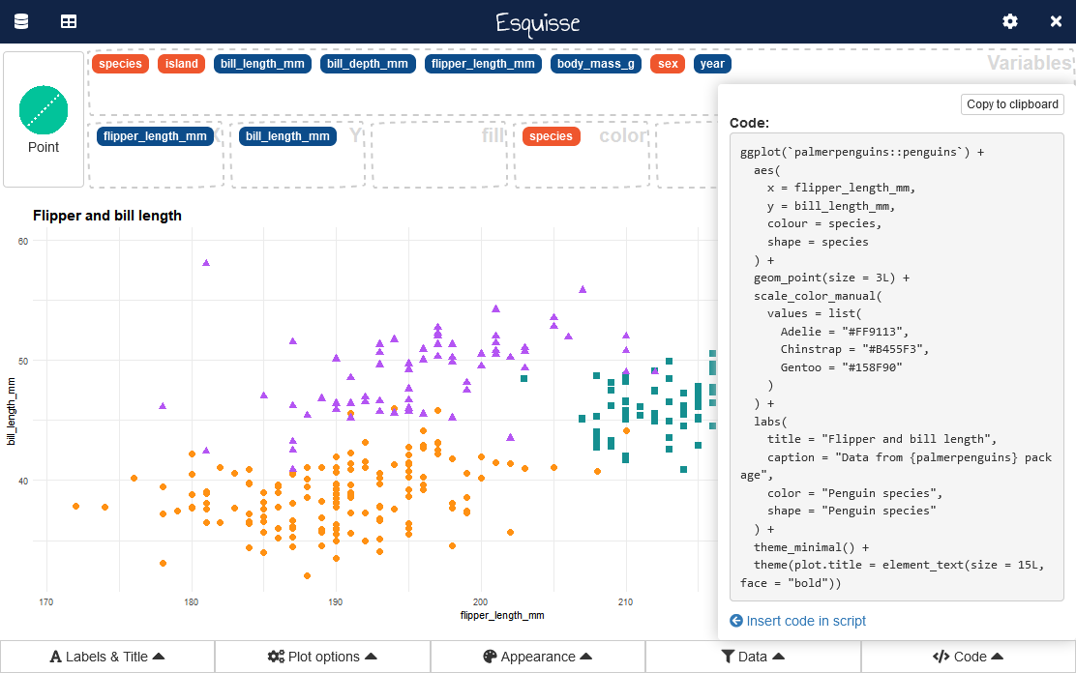
-Charticulator -Esquisse
Some fun resources for Data Viz!

Slide 20
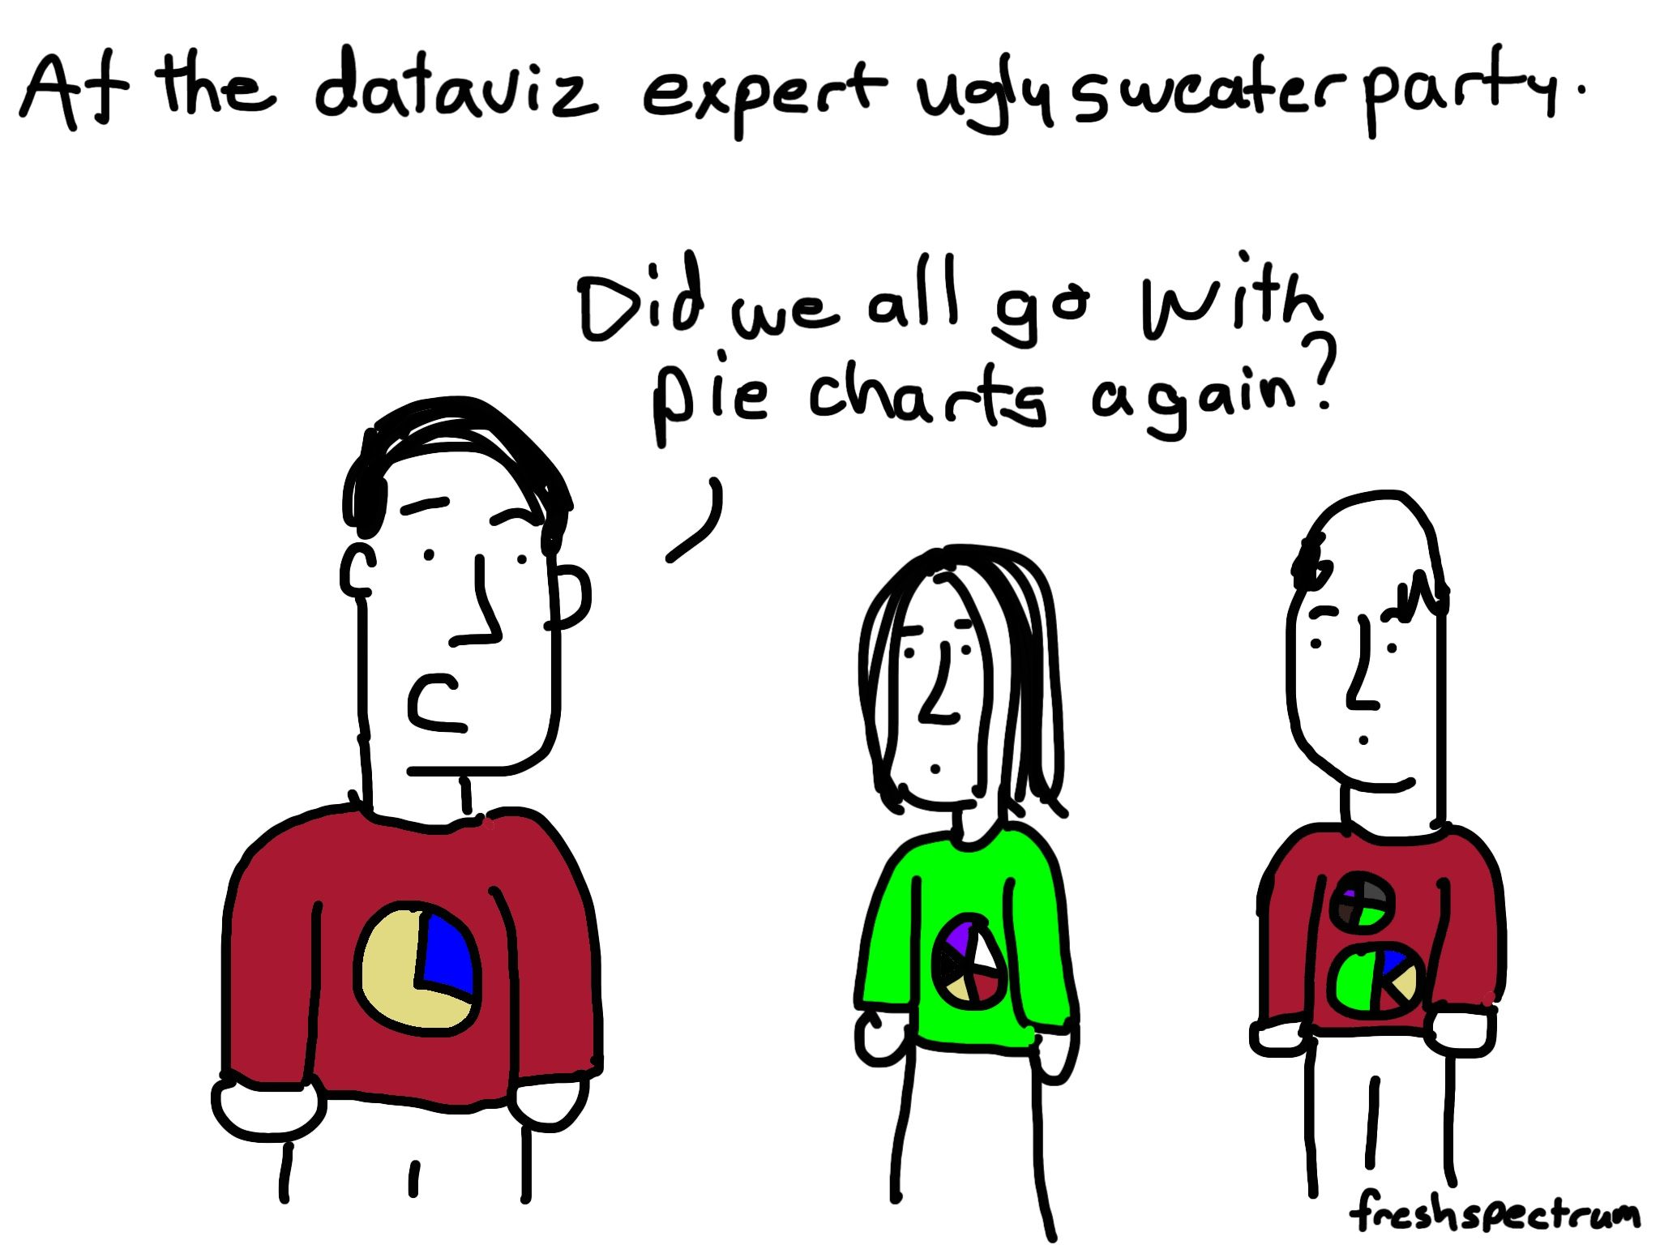
THANK YOU
Jasleen Sondhi
jasleen.sondhi@studentambassadors.com
https://linktr.ee/jasleen101010

